Slide 1
Semantic Search using Graph
Ferosh Jacob
Walton High School
March 12, 2019

Slide 2
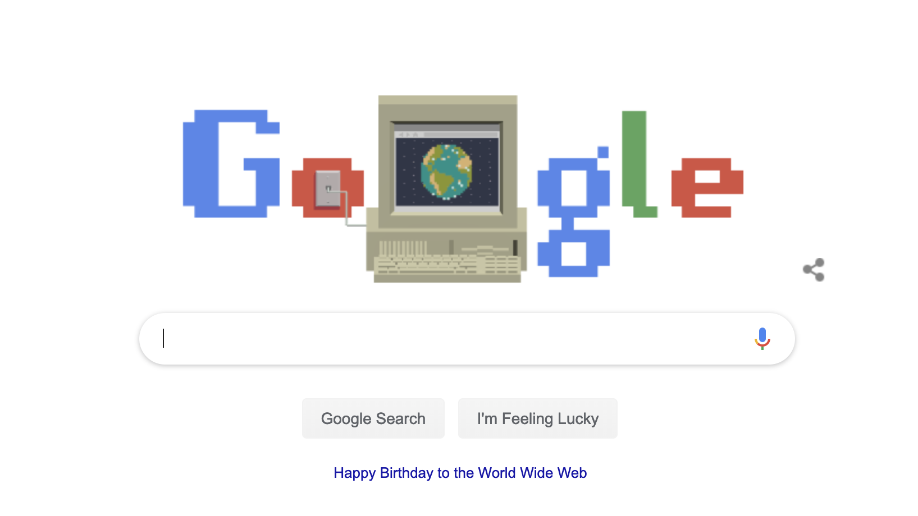
Let us Google….

Slide 3
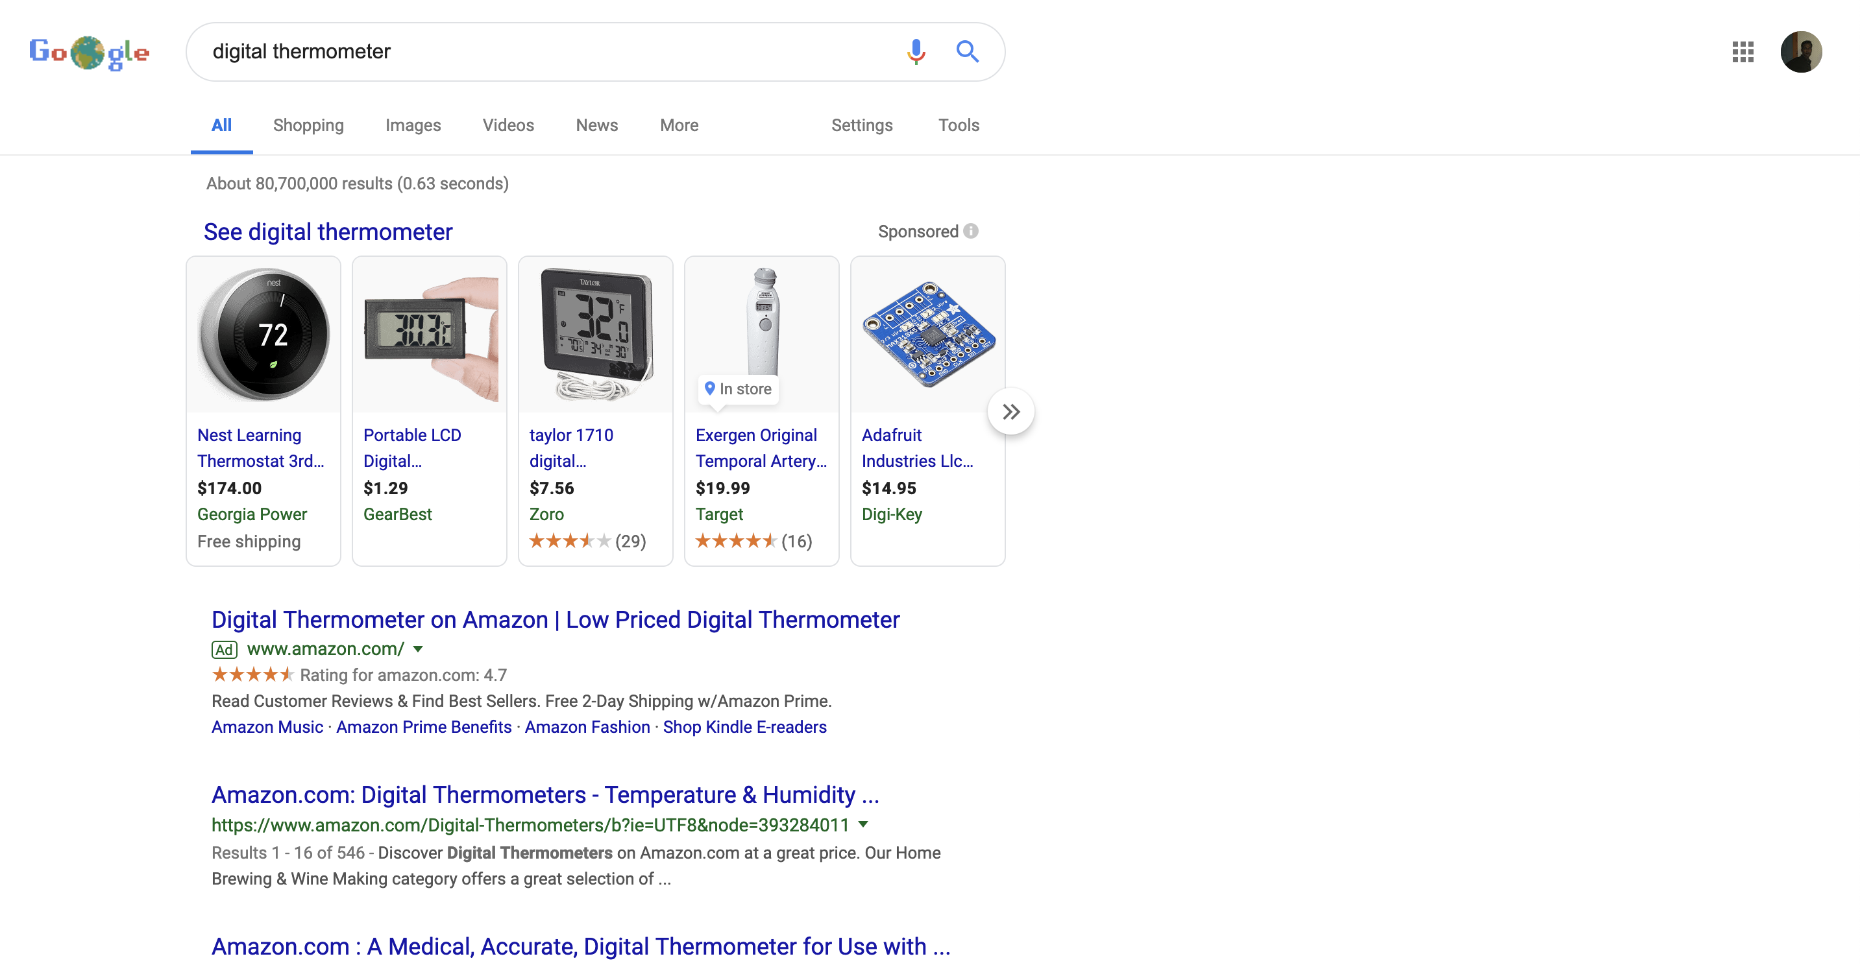

Why Google?

Slide 4
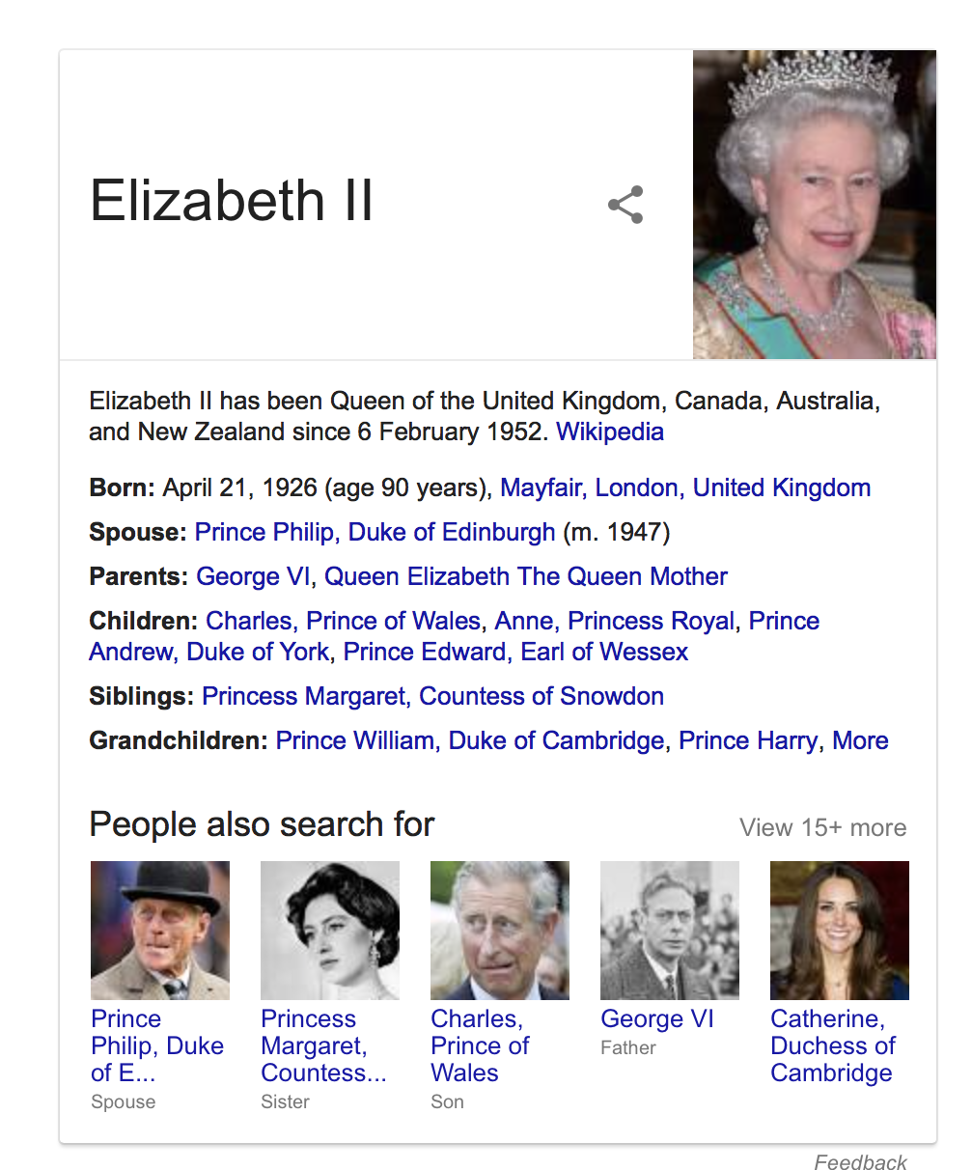
who is the queen of England?
Notes:
This is not an index search, the system understood the indent and answered the question making use of the famous knowledge graph

Slide 5
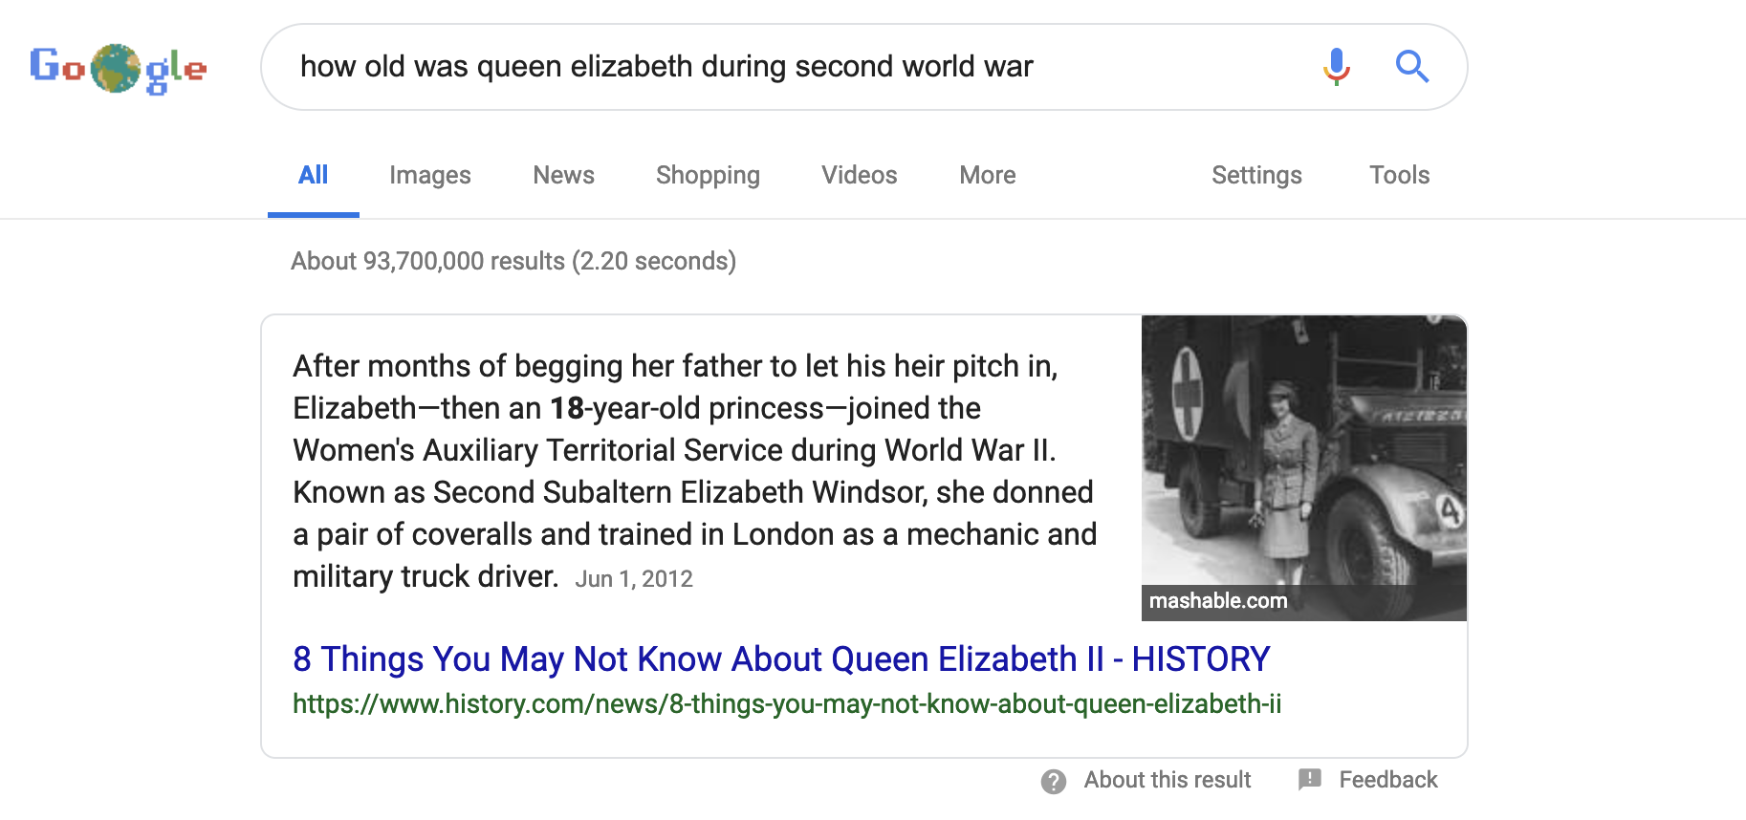
how old was queen Elizabeth during second world war
Notes:
This is not an index search, the system understood the indent and answered the question making use of the famous knowledge graph

Slide 6
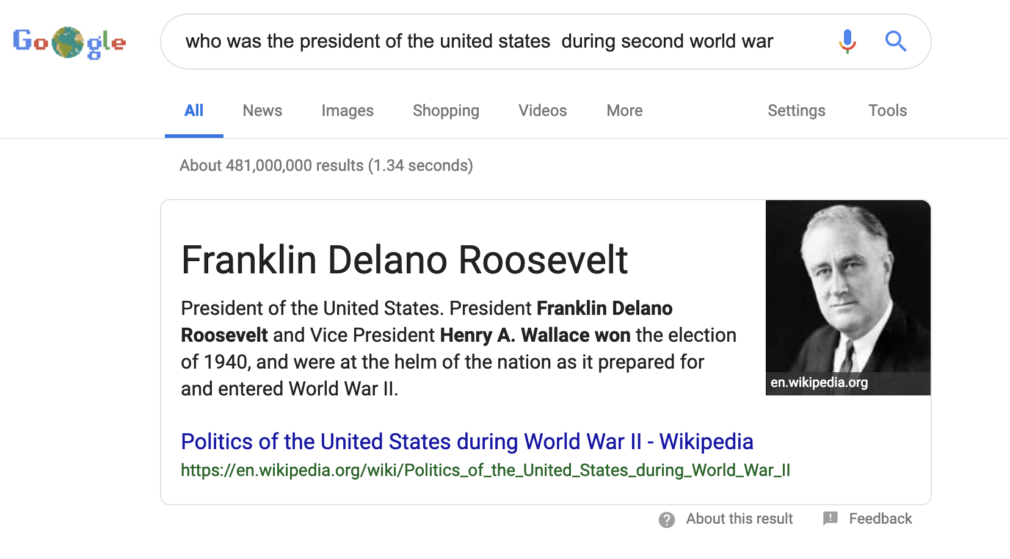
who was the president of the united states during second world war

Slide 7
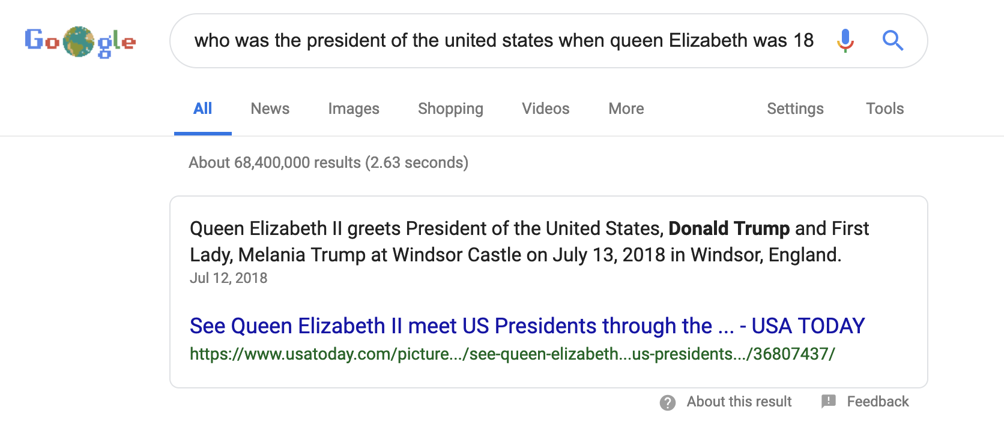
who was the president of the united states when queen Elizabeth was 18?
Notes:
This is not an index search, the system understood the indent and answered the question making use of the famous knowledge graph

Slide 8
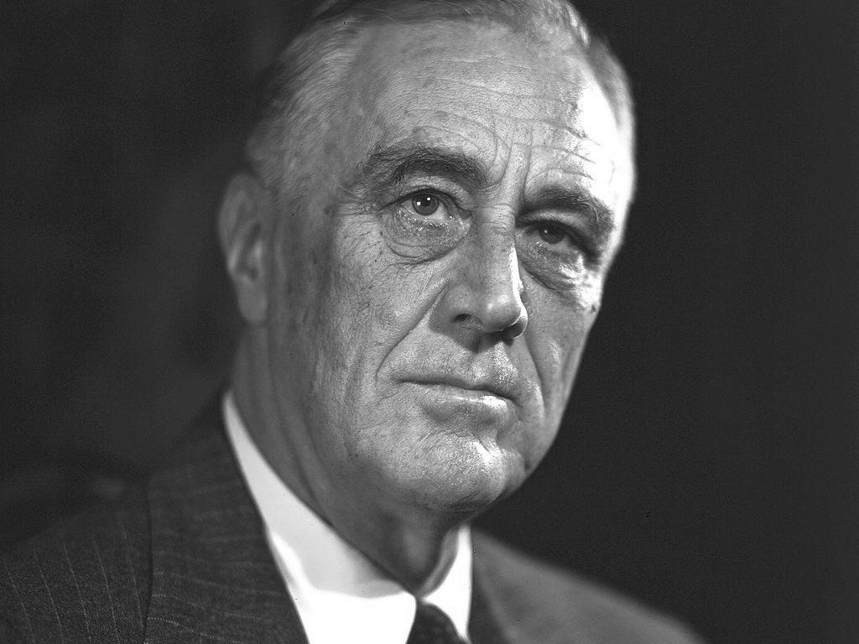
SEMANTIC WEB OVERVIEW
who was the president of the united states when queen Elizabeth was 18?
When was the queen Elizabeth 18?
1944 April 21 - 1945 April 21
Who was the president of the united states during 1944 April 21 - 1945 April 21 ?
Franklin D. Roosevelt (March 4, 1933 – April 12, 1945)
Harry S. Truman (April 12, 1945 – January 20, 1953)

Slide 9
SEMANTIC WEB OVERVIEW
President | Period
Dwight D. Eisenhower | January 20, 1953 – January 20, 1961
Queen | Coronation
Queen Elizabeth II | 1953 June 2

Slide 10
SEMANTIC WEB OVERVIEW
President | Period | Country
Dwight D. Eisenhower | January 20, 1953 – January 20, 1961 | USA
Queen | Coronation | Country
Queen Elizabeth II | 1953 June 2 | UK

Slide 11
SEMANTIC WEB OVERVIEW
President | Period | Country
Ref(Dwight D. Eisenhower) | Ref(January 20, 1953 – January 20, 1961) | Ref(USA)
Queen | Coronation | Country
Ref(Queen Elizabeth II ) | Ref(1953 June 2) | Ref(UK)

Slide 12
SEMANTIC WEB OVERVIEW
President | Period | Country
Queen | Coronation | Country
Ruler | Period | Region
Ruler’ | Period | Region
Ruler | Period | Region
Ref(Dwight D. Eisenhower) | Ref(January 20, 1953 – January 20, 1961) | Ref(USA)
Ref(EisenHower) is an instance of the Class Ruler
Ref(Elizabeth) is an instance of the Class Ruler’
Ref(USA) is an instance of the Class Country
Ref(UK) is an instance of the Class Country
Class Country is a type of the Class Region
Ref(USA) is ruled by the Class President
Ref(UK) is ruled by the the Class PrimeMinister

Slide 13
SEMANTIC WEB OVERVIEW
President | Period | Country
Queen | Coronation | Country
Ruler | Period | Region
Ruler’ | Period | Region
Ruler | Period | Region
Ref(Dwight D. Eisenhower) | Ref(January 20, 1953 – January 20, 1961) | Ref(USA)
Ref(EisenHower) is an instance of the Class Ruler
Ref(Elizabeth) is an instance of the Class Ruler’
Ref(USA) is an instance of the Class Country
Ref(UK) is an instance of the Class Country
Class Country is a type of the Class Region
Ref(USA) is ruled by the Class President
Ref(UK) is ruled by the Class PrimeMinister

Slide 14
SEMANTIC WEB OVERVIEW
SELECT ?location
WHERE
{
?y rdf:typeOf <http://www.w3.org/2001/vcard-rdf/3.0#Family> .
?y skos:prefLabel ”Smith" @en .
?y geo:point ?location .
}
SPARQL queries

Slide 15
SEMANTIC WEB OVERVIEW
PREFIX dbo: <http://dbpedia.org/ontology/>
PREFIX dbp: <http://dbpedia.org/resource/>
PREFIX foaf: <http://xmlns.com/foaf/0.1/>
SELECT ?name ?bandname where {
?person foaf:name ?name .
?band dbo:bandMember ?person .
?band dbo:genre dbp:Punk_rock .
?band foaf:name ?bandname .
}
SPARQL query 2
Reference: http://stackoverflow.com/questions/35595777/simple-sparql-query-from-dbpedia

Slide 16
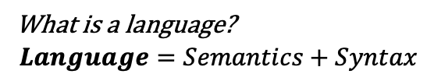
SEMANTIC WEB OVERVIEW ONTOLOGY and KNOWLEDGE BASEs
Java language grammar
Spark Java program
Javafx program
SKOS, RDF, FOAF …
DBpedia
Freebase
English language grammar +global dictionary
“One Hundred Years of Solitude”
“The Old Man and the Sea”
What is a language?
$$Language=Semantics+Syntax$$
What is an instance of the language?
An ontology is the “language” of a knowledge base.

Slide 17
SEMANTIC WEB OVERVIEW FORMAL DEFINITIONS
What is semantic web?
Semantic Web” refers to linked data across the internet. It is built using the semantic frameworks provided by RDF and other ontology technologies.
What is an Ontology?
“Ontology” is a term that can have many meanings for different people and contexts and depending on who you’re talking with, this can be controversial. However, nearly all definitions have a common element: an ontology is a model of knowledge.
What is a Knowledge base?
Given a domain ontology and domain data, a knowledge base would be the result of organizing the domain data according to the ontology. Very roughly comparable to a database schema and the data.

Slide 18
SEMANTIC WEB OVERVIEW FORMAL DEFINITIONS (CONT’D)
What are Ontology Concepts and Relations?
An ontology is formed of concepts and their relations, not keywords. There can be label information, but the nodes of an ontology are concepts. In OWL, these are classes.
Two concepts are linked through relations.
What is RDF?
RDF* is the underlying specification used to realize an ontology or knowledge base. OWL is specifically for ontologies and is a supertype of RDF.
What is OWL?
OWL is a semantic extension of RDF for knowledge representation. OWL introduces classes, class properties, and axioms. OWL also includes support for ontology importation, analogous to source importation, so that an ontology can refer to other ontologies’ namespaces and classes.
*http://www.w3.org/TR/2004/REC-rdf-concepts-20040210/

Slide 19
SEMANTIC WEB OVERVIEW FORMAL DEFINITIONS (CONT’D)
What are Triples?
Different from an Entity-Attribute-Value model, the Subject-Predicate-Object focuses on statements about objects. To declare that some entity has a value, the predicate would be a having relation and the object would be the instantiated concept that would then have a triple assigning it the value.
For example:
Statement: The sky is blue
EAV model: sky-color-blue
SPO model:
skyInstance876453-hasColor-colorInstance123222; colorInstance123222-hasValue-blue

Slide 20
PART 1: SEMANTIC WEB OVERVIEW FORMAL DEFINITIONS (CONT’D)
What is inferencing/entailment?
Drawing conclusions within the KB (using axioms)
Can be operated on usual ISA/SAME-AS relations, or custom axioms
THD-related ontology snippets, in n-triples
thd:HammerDrill rdf:subClassOf thd:Drill
thd:ScrewGun rdf:subClassOf thd:Drill
thd:Scrugun owl:sameAs thd:ScrewGun
thd:Drill owl:equivalentClass thd:Driver
thd:Drill rdf:subClassOf thd:PowerTool
Instances
thd:sku_123 rdf:type thd:HammerDrill
thd:sku_456 rdf:type thd:Scrugun
thd:sku_789 rdf:type thd:Driver
Query
SELECT ?x
WHERE {
?x rdf:type thd:Drill
}
Results:
Without inferencing: {Empty set} – there are no instances of type thd:Drill
With inferencing: {thd:sku_123, thd:sku_456, thd:sku_789}

Slide 21
Questions?
Thanks Mitchell Bowden for allowing me to reuse some of his slides

